Slide 1
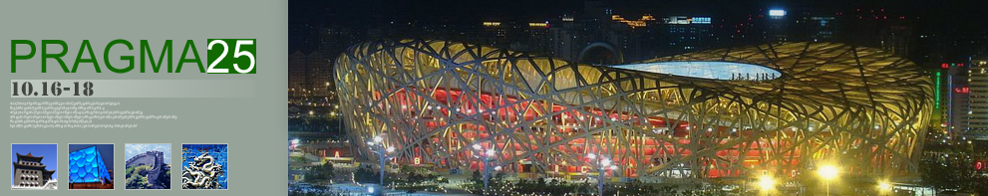

Overview of PRAGMA Progress since PRAGMA 24
2013 October 16 - 18

Slide 2
Thank You Computer Network Information Center
Director Huang Xiangyang, CNIC, Chinese Academy of Sciences
Deputy Director Nan Kai, CNIC, CAS
Dr. Dong Kejun (Kevin), CNIC, CAS
Many others including Sponsor Dell
For Hosting our 25th PRAGMA Workshop
Notes:
http://sourcedb.cas.cn/sourcedb_cnic_cas/yw/people/200908/t20090817_2404531.html
This is our 25th Workshop! Congratulations – and a special thanks for having CNIC host this workshop!

Slide 3
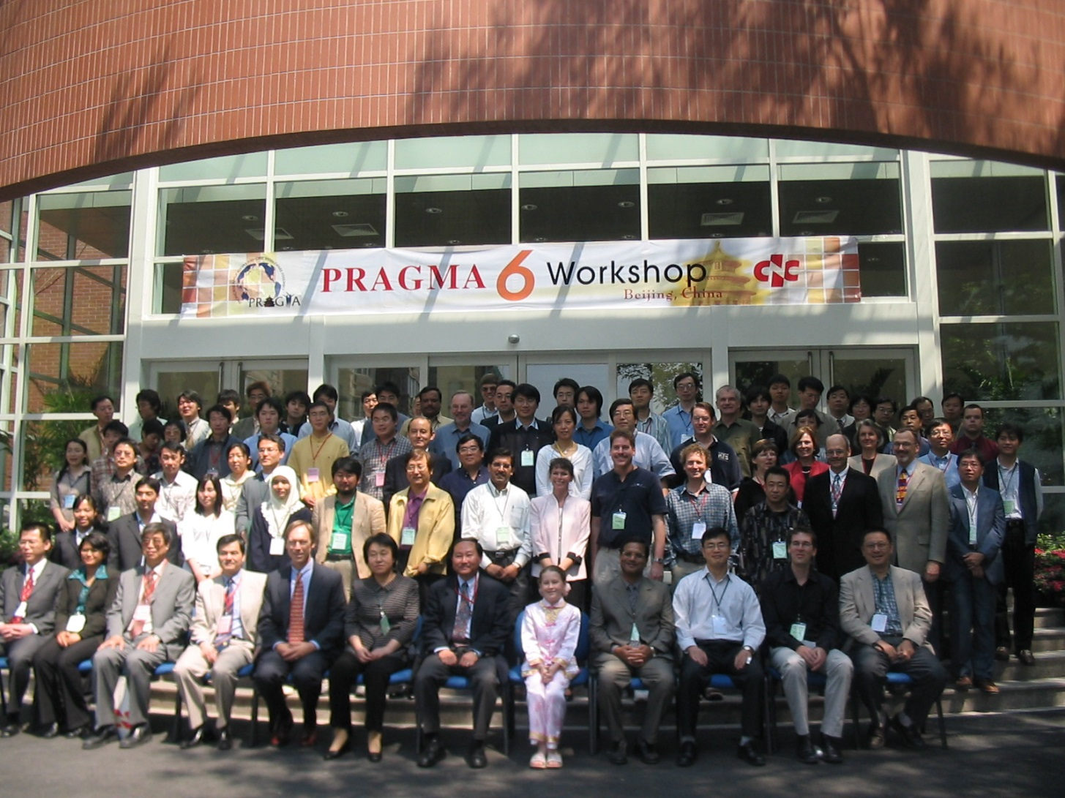

PRAGMA 6 17 – 19 May 2004
Notes:
We held our sixth PRAGMA workshop at CNIC, nearly 10 years ago.

Slide 4
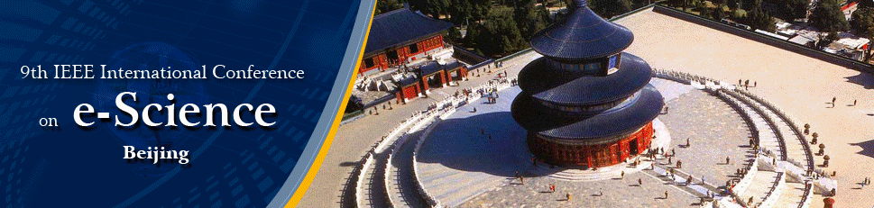
Congratulations
22 – 25 October 2013
Organized by CNIC
Notes:
Committees: https://escience2013.csp.escience.cn/dct/page/65578

Slide 5
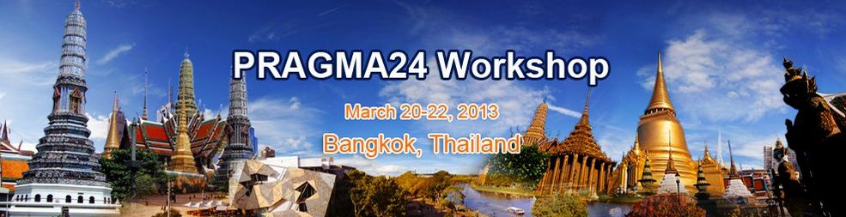
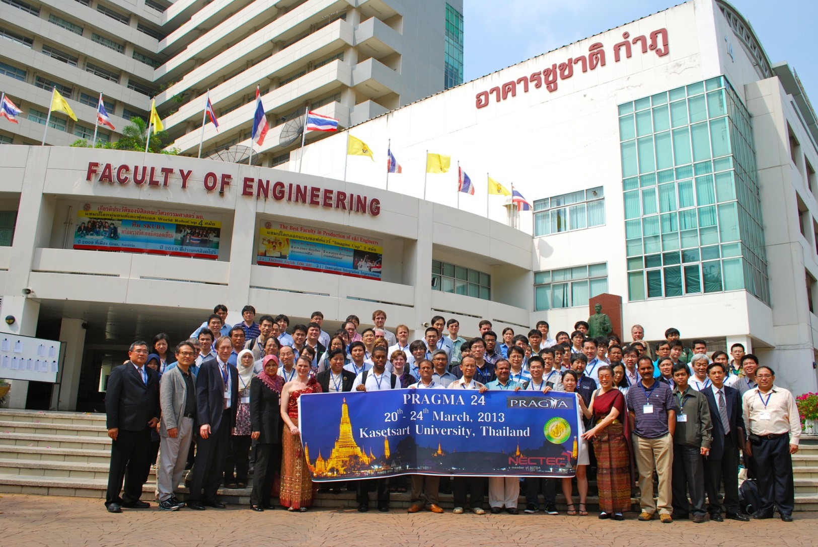

Notes:
The purpose of this presentation is to give an update on what has happened since PRAGMA 24, when we were in Bangkok, hosted by Kasetsart University, in a meeting that was co-organized with help from NECTEC.

Slide 6
Enabling the Long-Tail of Science through Scientific Expeditions and Infrastructure Experiments for Pacific Rim Institutions and Researchers
PRAGMA
Members
and
Affiliates
Notes:
For individuals new to a PRAGMA workshop – welcome!
As science becomes more distributed and collaborative, there are small to medium sized groups, distributed, that want to work together. PRAGMA is about enabling this long tail of science, through scientific expeditions and infrastructure experiments.
We have always focused on the Pacific Rim. You can see the institutions involved. This includes the four new sites that were accepted as members at PRAGMA 24

Slide 7
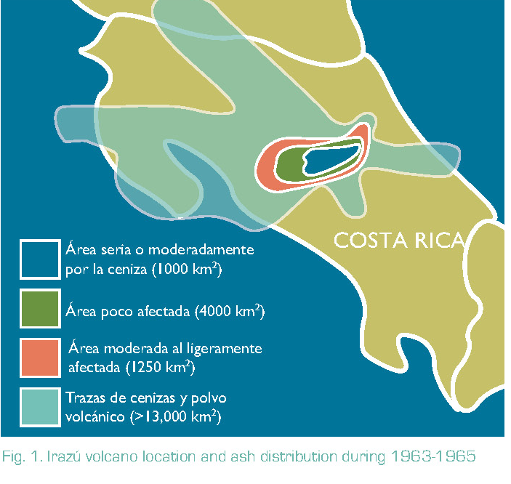
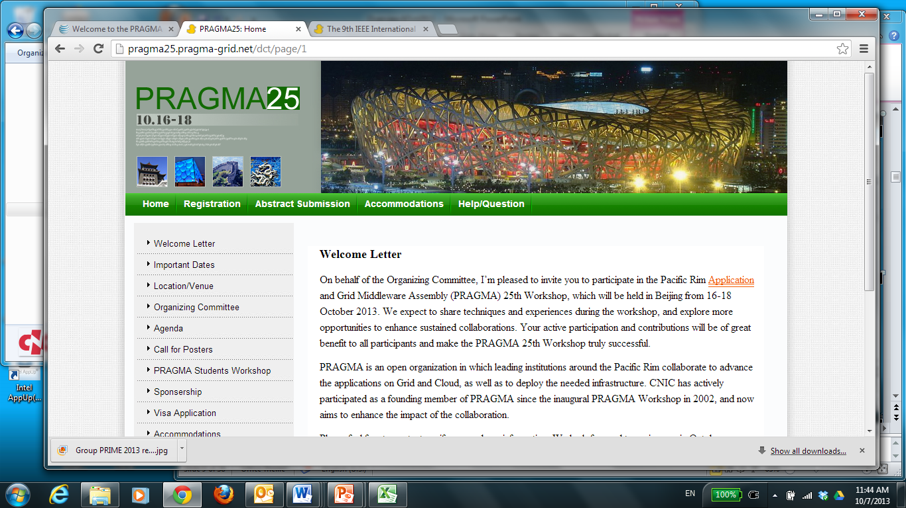
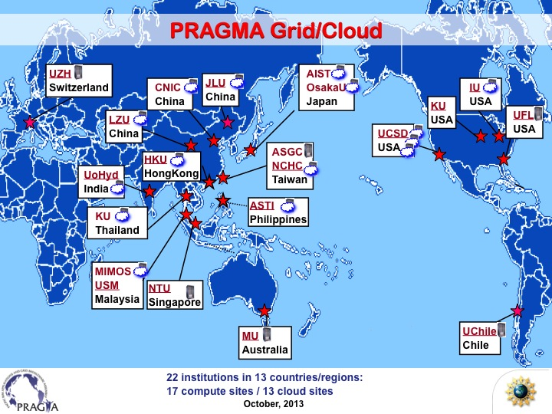
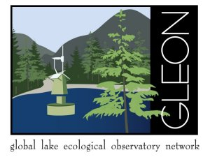
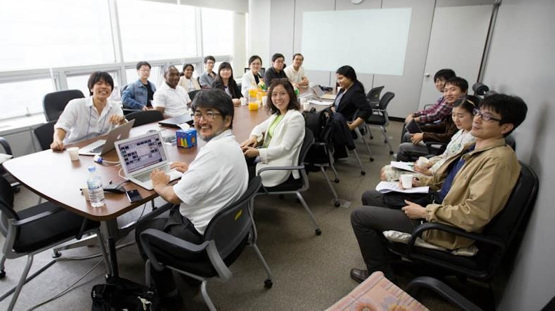
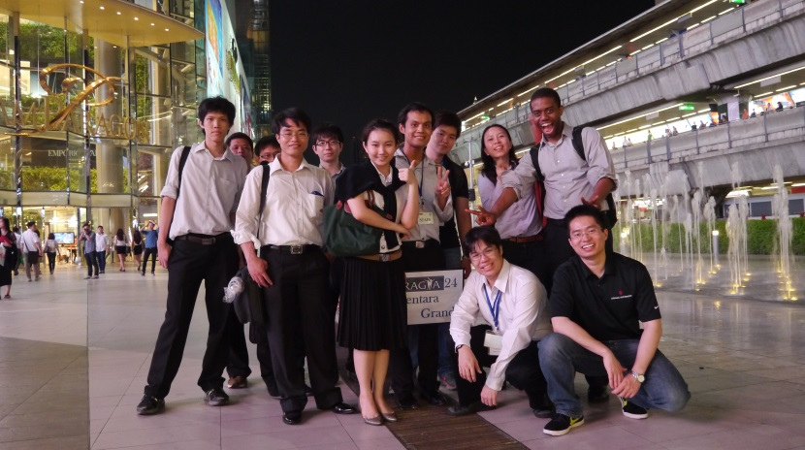
Accomplishments
Distribution of ash:
Irazu volcano 2010
Advanced scientific understanding
Developed, tested, improved, shared approaches and software
Created PRAGMA cloud
Built communities
Trained students
Evolved with technology and needs: Grid to Cloud
Encouraged trust and new idea and partners
Developed CNIC
Open-source
Used since
PRAGMA 18
Notes:
Public declaration of interest of Advanced Data Networks, e-Science and Supercomputing in Costa Rica (on/about Oct 14 2013
Let me give you a brief set of highlights of what
Simulated distribution of ash from the Irazu volcano (see PRAGMA Collaborative Overview 2010 – 2011, http://goc.pragma-grid.net/pragma-doc/overview/2010.pdf). Key points
Driven by concern of huge population growth in the fallout path
This “experiment” was stimulated by discussions at PRAGMA 18, with the Resources Working Group
David Abramson got involved (parameter Sweep – NIMROD)
Also Phil applied for and got time to use Amazon EC2 for this application
It did result in at least one publication
Duckling: Open source software developed by CNIC (Kevin Dong one of the key leads). Software for collaboration. PRAGMA has used this software for all of its workshops since PRAGMA 18 (March 2010). It is also being used for the 9th IEEE escience meeting website. Just look at the tab.
PRAGMA Cloud: This is created by members working together, sharing resources to run both technology experiments and applications. The PRAGMA cloud is a place to experiment before bringing activities into local/national infrastructures.
Communities: The Global Lake Ecological Observatory Network (GLEON) started as an expedition to place a sensor in a lake in Taiwan and stream data to the world. The early expedition started in 2003, with data streaming 7 months later in 2004. It was based on NCHC’s investment in Eco-Grid, and PRAGMA’s investment in this experiment. Many publications came out this, and much software improvement. But the lasting impact has been GLEON. There are currently more than 400 members (Oct 7 2013) and they are conducting new research that integrated data from multiple lakes. Their organization had a vibrant GLEON Students Association (GSA) which motivated PRAGMA to explore how it can provide research, leadership, and professional experiences to graduate students.
Much of what follows will highlight areas where PRAGMA has migrated to cloud technologies, by engaging researchers in SDN and in Data. We also will highlight ongoing activities to engage new members.
In fact, we move workshops to different sites to encourage greater involvement in PRAGMA.

Slide 8
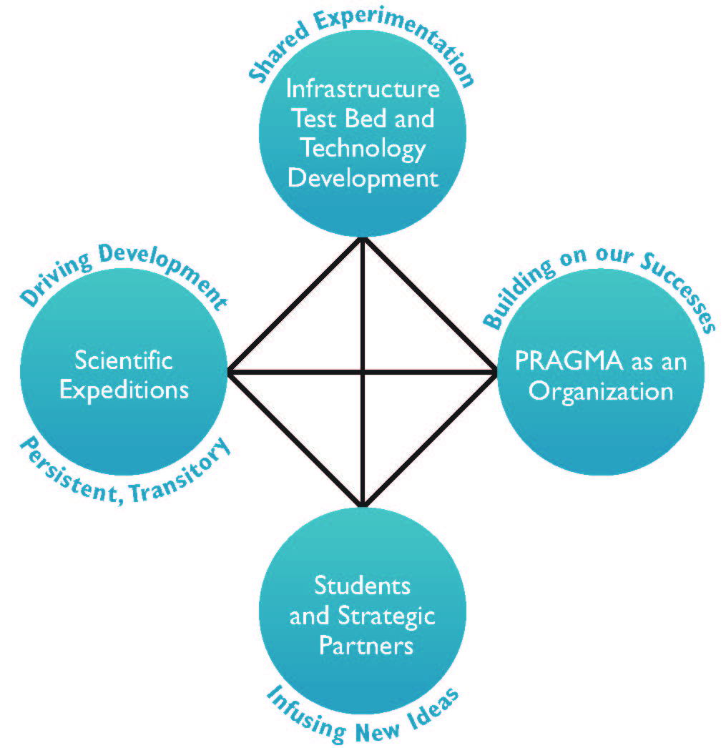
PRAGMA’s Overarching Activities to Enable Long Tail of (Team) Science
Foster international scientific expeditions
Develop and improve a grassroots, international cyberinfrastructure
Infuse new ideas through students and strategic partners
Build and enhance the essential people-to-people trust fabric
Interdependence Essential
Notes:
PRAGMA is focused on four pillar-like activities, which do not stand alone. You will see how the scientific expeditions (virtual) interact with the infrastructure; how getting new researchers (e.g., SDN) have strengthened PRAGMA and allowed us to better address user needs. Students will play a larger role in PRAGMA activities, and help us have a larger impact.
As stated in the PRAGMA renewal: None of these can stand alone. Ideas become stale without new people. Infrastructure that has impact must be built to meet the specific needs of applications. And, scientific expeditions and data sharing require organizational support to succeed.
Building and enhancing the essential people-to-people trust fabric and organization developed through regular face-to-face meetings, a core component of PRAGMA’s success;
Developing and improving a grassroots, international cyberinfrastructure for testing, computer science insight, and application support through sharing resources, expertise, and software;
Constructing international “scientific expeditions” to advance specific scientific needs while developing and testing the underlying technologies that are needed to create usable, international-scale, cyber environments through forging teams of domain scientists and cyberinfrastructure researchers;
Infusing new ideas from developing new researchers with experience in cross-border science and engaging strategic partners.

Slide 9
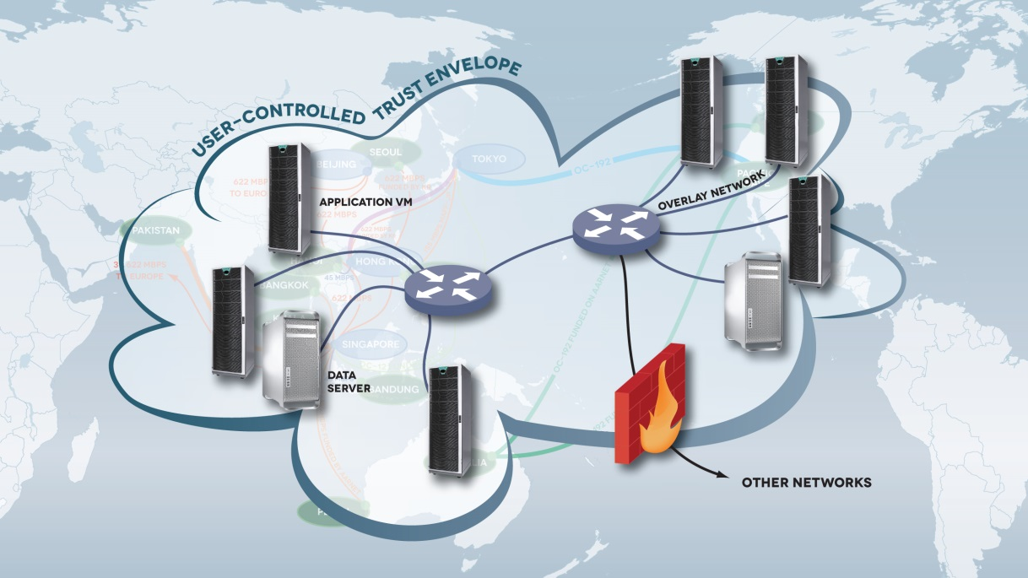
Grass-roots International CI: User-defined Trust Envelop
Components
Challenge: Integration
and a Plan for Trust Envelop
VM image, virtual cluster porting
Software defined overlay networks
Data cloud & provenance
Observing systems
Importance of
Trust Envelop
Traverse firewalls and simplify network re-configuration of application VMs
Provide an infrastructure that initially limits access to data
Using the Expeditions to Drive
Development of a
TRUST ENVELOPE
Notes:
One of the concepts focusing our efforts is that of a user defined trust envelop.
- This is driven my needs of users to more easily share computations and data; and at the same time limit the sharing to a known set of collaborators). Think of data that must be shared under certain conditions.
- This involved integration of technologies (virtual images, software defined networks, provenance)
- And ultimately would include sensors and sensor networks (or more generally mobile technologies)
Provide an infrastructure that initially limits access to data
Traverse firewalls and simplify network re-configuration of application VMs

Slide 10
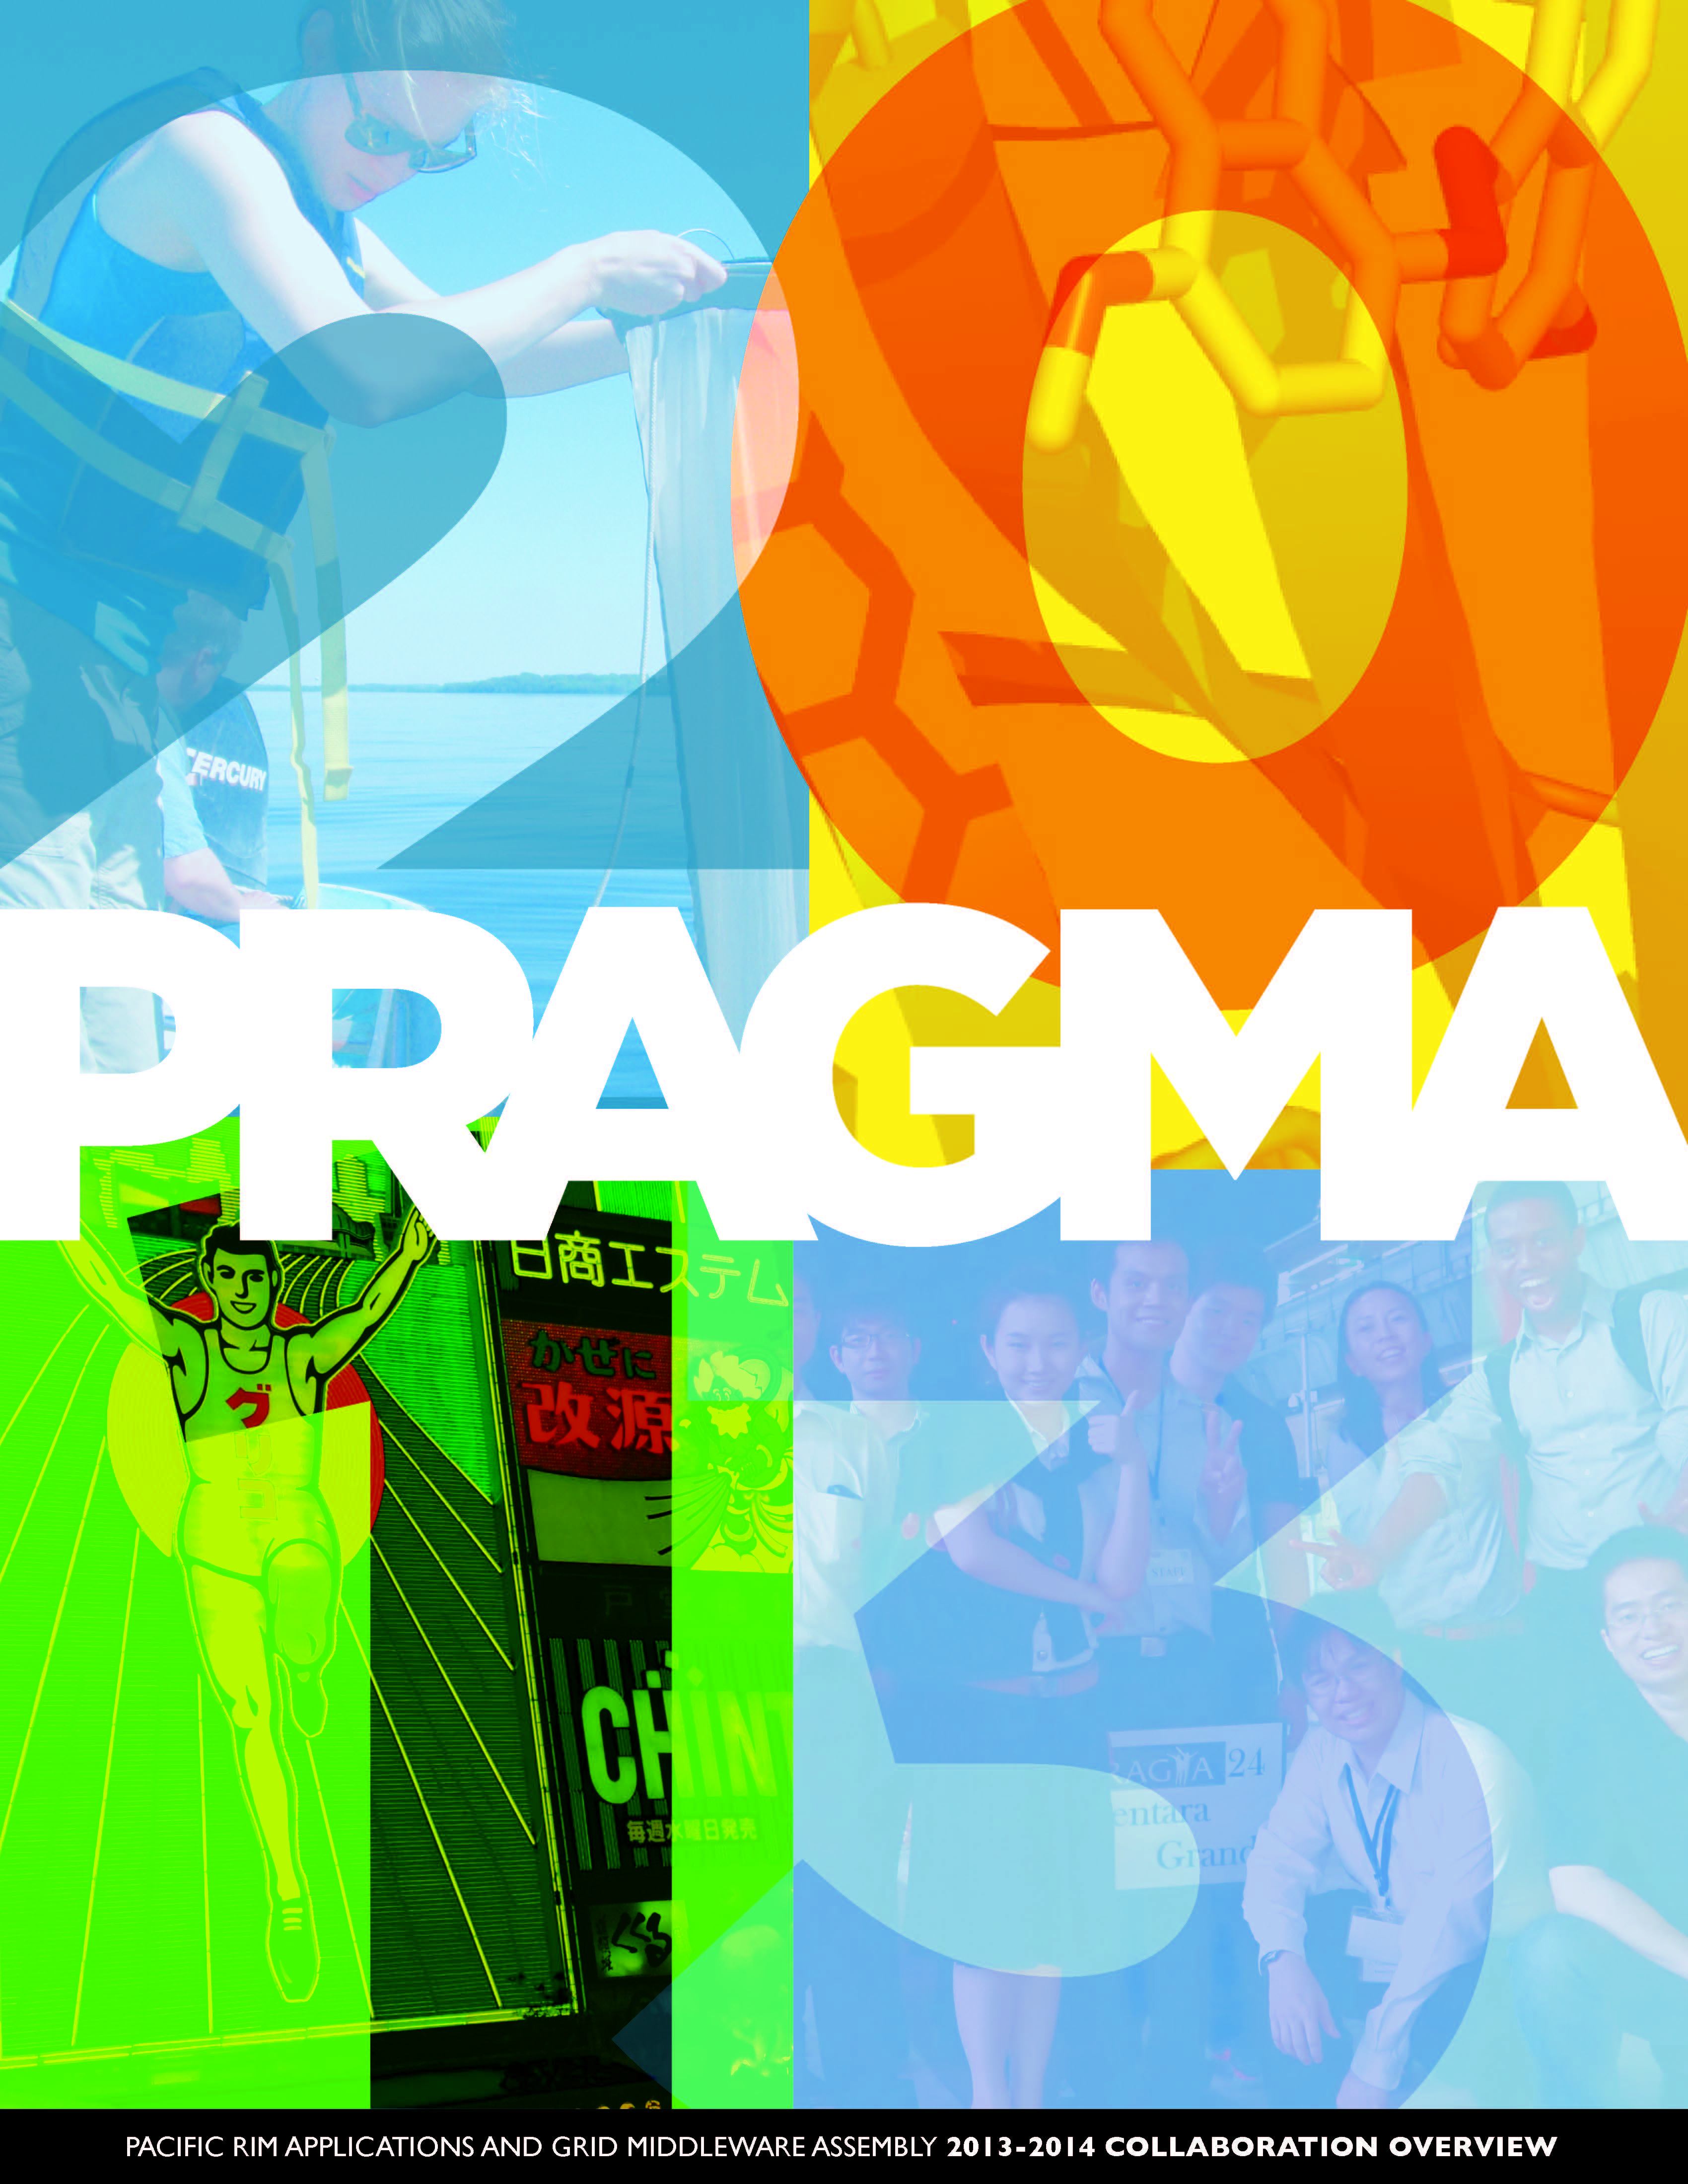
PRAGMA Collaborative Overview 2013 - 2014
Highlights
Demos you will see
PRAGMA Students
Community Building
Working Groups
Institutions and Sponsors
Finalized before SC13

Slide 11
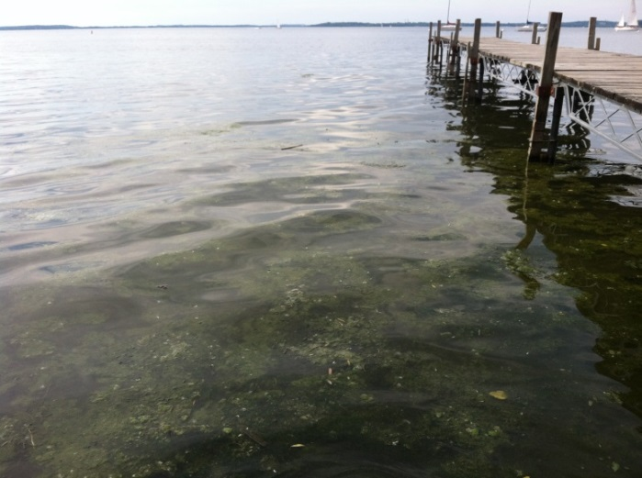
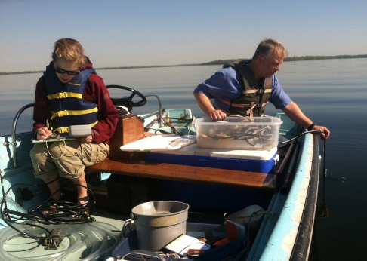
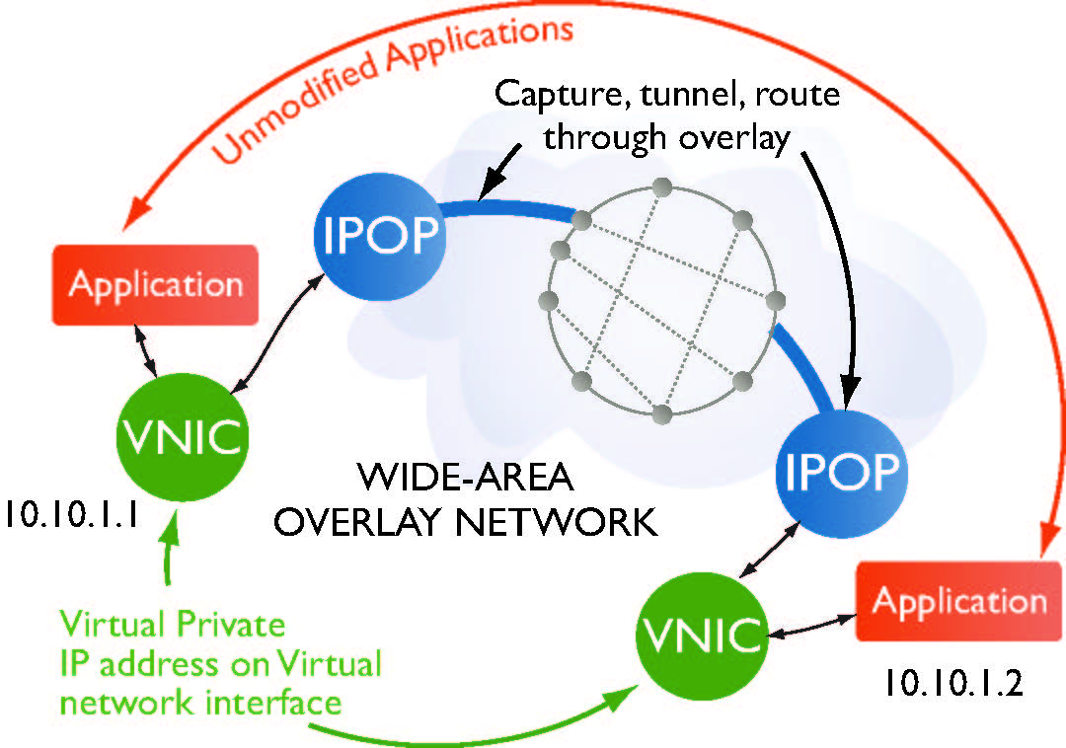
Predicting Water Quality in Lakes Learning Phytoplankton Rules using SDN
Indicators of water quality controlled by phytoplankton
Run multiple simulations to understand rules
Using VMs to avoid challenges of different architectures
Using IP-over-P2P (IPOP) to interconnect VMs across multiple institutions
Collecting light,
temperature data
Demo / Poster: Renato Figueiredo (U FL), Paul Hanson (U Wi), Cayelan Carey (VA Tech), Pierre
St. Juste, Kyuho Jeong (U FL, Grant Langlois, Luke Winslow (U Wi), Jonathan Doubek (VA Tech)
Notes:
Phytoplankton – microalgae
Photos:
Upper Right: Paul Hanson (U Wisc), Cayelan Carey (Virginia Tech) @ GLEON 'Spring Blitz'- I especially like the one of Paul lowering the light meter over the boat while I record the temperature profile! It is good to remind people that sometimes you really have to get out and do some data collection, as input into computational models.
Upper Middle: Phytoplanton visible on Lake Mendota (Center for Limnology dock, UW, Madison) – this is what the team is trying to understand – namely the rules to govern phytoplanton growth.
Figure: IPOP (Jose, you will know how to explain this).

Slide 12
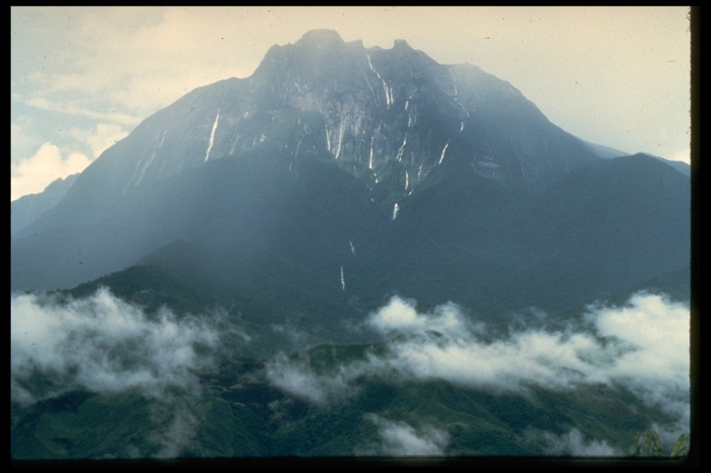
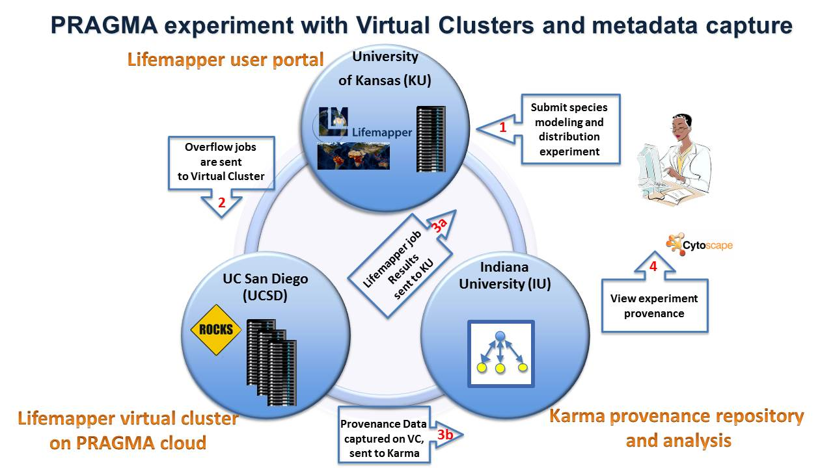
Biodiversity in Extreme Environments Distribution Prediction by Sharing CI and Provenance Capture
Mt Kinabalu: Biodiversity rich, extreme (toxic) environment
Lifemapper software predicts spatial distribution
Goal is to share computation data in trusted network
Improve efficiency, portability and capture provenance
Pushed Virtual Cluster technology, improved Lifemapper, incorporated Karma provenance
Additional Work of Expedition
Gained remote sensing data
Expanded interactions
Demo: Nadya Williams (UCSD),
Aimee Stewart (KU), Quan Zhou (IU)
Notes:
Four Images:
Upper right – Mt Kinabalu, Sabah
Lower right – Workflow of demo at PRAGMA 25, that has moved part of Lifemapper out of dedicated server at KU, added computational provenance along with simulation experiment metadata.
Left: Two images: Top is Landsat (circa 1991), Bottom is QuickBird (2008). See explanation below. Purpose of adding here is to indicate that work will begin to look at remote sensing images to understand species distribution in the ultramafic region.
Hope that the text on the slide is clear.
SECOND MAIL
Peter - I didn't have the date of acquisition on the quickbird imagery in hand as I wrote the caption, but it is 2008. I'll get the month of capture asap. The WorldView2 imagery will be available to us in about 1 week (and so couldn't include it in this set of images) and is June, 2013. Change detection is possible, but it would be subtle in most protected areas, such as Kinabalu Park. However, there are effects of tree-crown death that were quite apparent to the eye in 1995-1997, during some severe droughts. I'm not sure how comparable to the three sets of images would be from a climate change perspective. However, I believe there's a 200x Landsat image that is relatively cloud free and would be interesting from that angle.
FIRST MAIL
Figure X1. Top: Landsat 5 image of Mount Kinabalu (June 1991) and surrounding landscape with three ultramafic outcrops, of many, identified shown as a true-color composite of visible bands 3, 2, and 1. Ground resolution is ca. 28.5 m per pixel. The image is a rare cloud-free data capture. Below: The same three ultramafic outcrops are shown on a high resolution Quickbird image combining panchromatic (60 cm ground resolution) and multispectral bands 4, 3, and 2 (2 m ground resolution). This view is a false-color infrared composite where the ultramafic areas are easily distinguished to the eye as darker red and smoother texture because of the smaller stature of cloud forest vegetation.

Slide 13
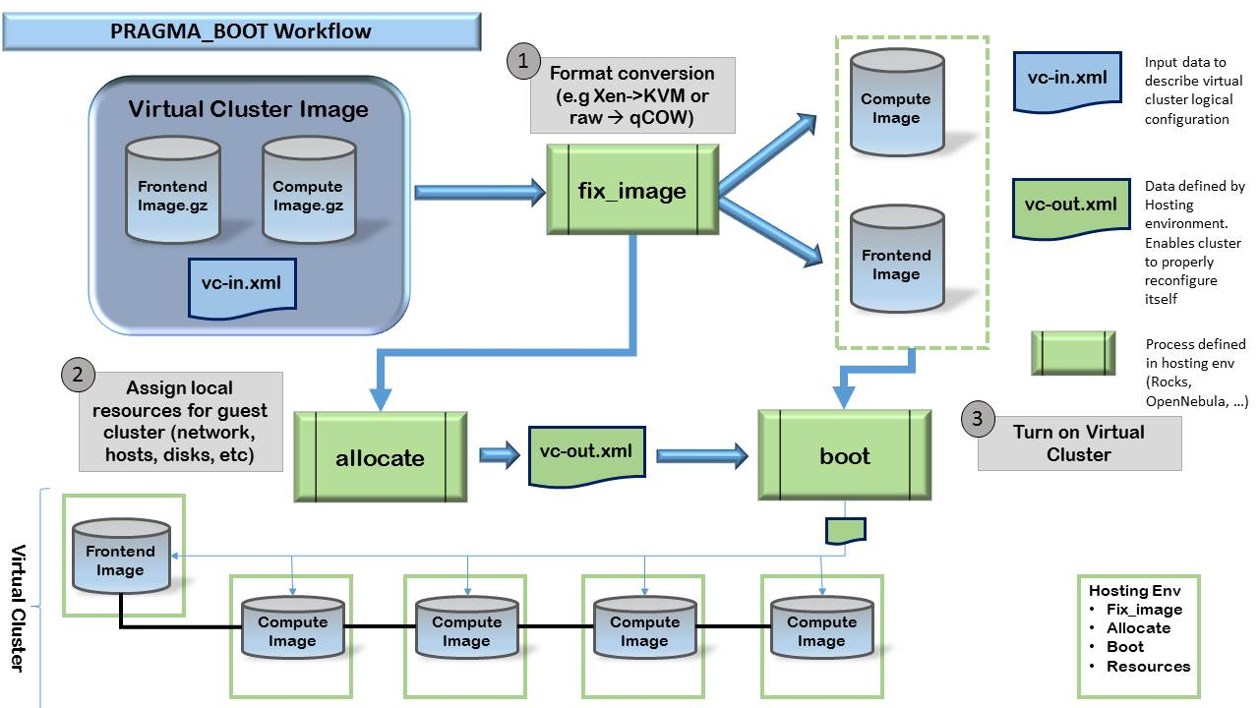
PRAGMA VC Sharing Automation Phase 4
For specialized applications: “build once, run easily everywhere”
Share a virtual machine image among multiple hypervisors (Xen and KVM, and Virtual Machine (VM) and hosting middleware (Rocks, Ezilla, OpenNebula, Amazon EC2)
Developed pragma_boot to automate VC translation
Demo: U-chupala, Pongsakorn, Ichikawa Kohei (NAIST); Clementi Luca, Williams Nadya,
Papadopoulos Philip (UCSD) Tanaka Yoshio, Ota Akihiko (AIST) Huang Weicheng (NCHC)

Slide 14
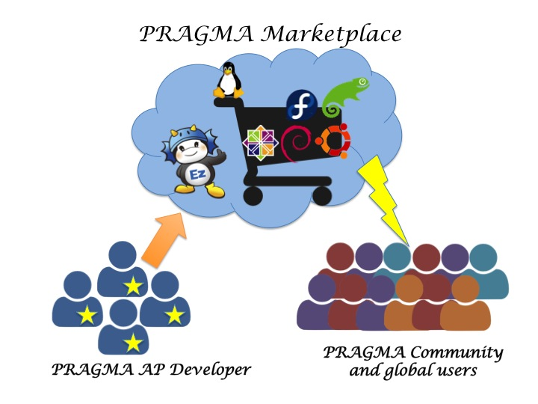
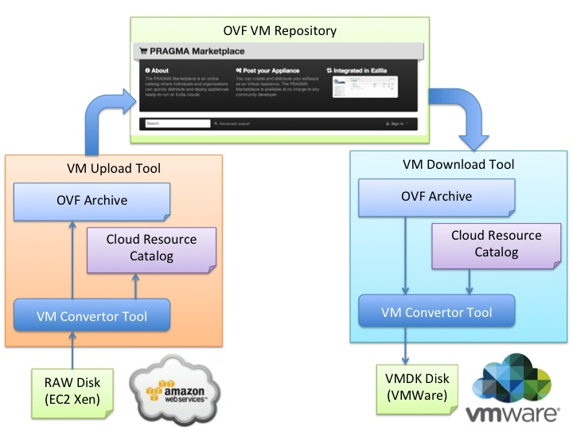
Lightweight Cloud Application Marketplace
Metadata Service to bridge cloud users and available VM images Provides registration service for vm owners (storage designated by owner)
Provides tool to convert between VM formats
http://140.110.30.2:6242/appliance
Demo: Chi-Ming Chen, Kuo-Yang Cheng, Weicheng Huang (NCHC);
Yoshio Tanaka (AIST), Luca Clementi, Nadya Williams, Philip Papadopoulos (UCSD)
Notes:
Note: There is a second image under the first – both images from from Weicheng Huang, NCHC.
The Marketplace provides a metadata service to bridge Cloud users and the VM images available. The VM images registered on the Marketplace can be stored in the physical storage preferred by the owner of the image, and various VM repositories can be federated together with flexibility. In addition, a small tool is available for the community to convert the VM format before or after the registration of the VM onto the Marketplace to help the interoperability of clouds.

Slide 15
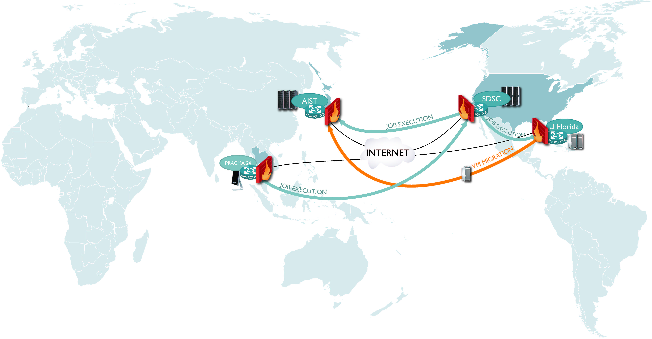
ViNe: Software Defined IP Overlays Infrastructure (VR) and Management
ViNe (U FL): SDN establishes wide-area IP overlays (public, private networks)
ViNe live migration of VM illustrated at PRAGMA 24
Future: expand PRAGMA sites; user defined isolated overlays
Demo: Mauricio Tsugawa (U FL);
Nadya Williams, Luca Clementi,
Phil Papadopoulos (UCSD)
Notes:
This is in the PRAGMA Collaborative Overview which covers the last year.
This mostly is what happened at PRAGMA 24 (you were there). I am including it my talk to hit the highlights of the brochure.

Slide 16
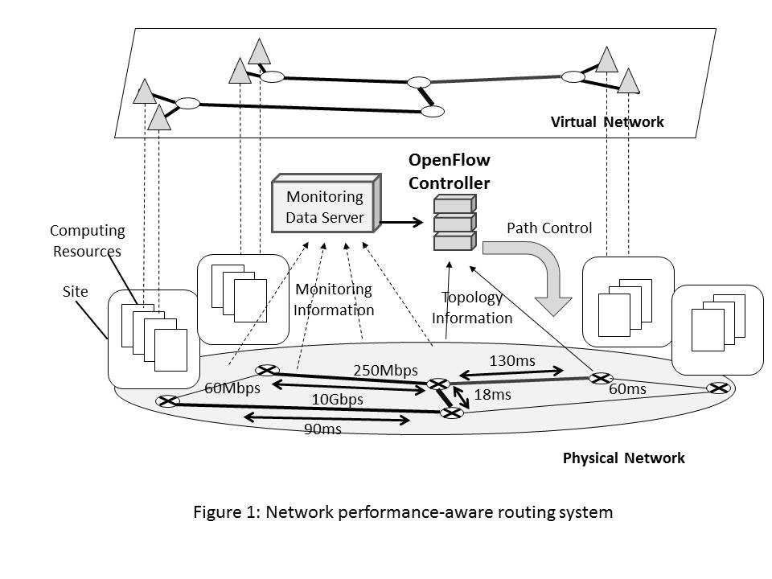
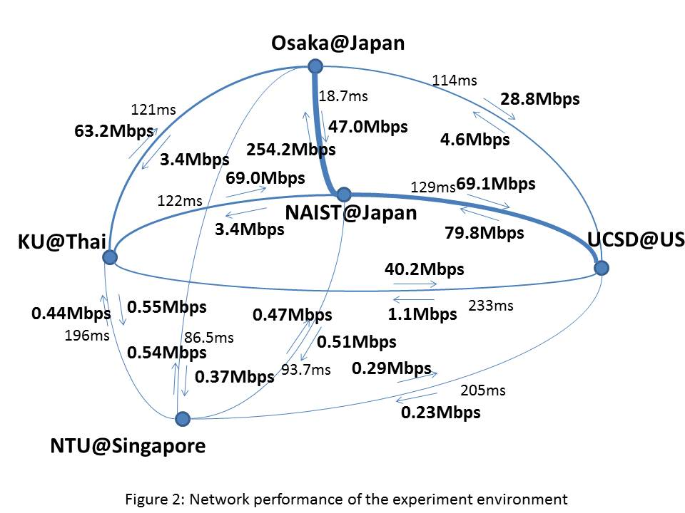
OpenFlow Controller and Collaboration
Developed OpenFlow Controller, and measured performance five sites (NAIST, Osaka, NICT, others)
Will build in a distributed network monitoring system “OverLoad” developed by Kasetsart U team (based on PRAGMA 24 discussions)
Notes:
Distributed network monitoring system, “OverLoad”, developed by the Kasetsart University team
Key point is more that PRAGMA workshops are a place to discuss ideas and identify projects of common interest.
This is a repeated benefit in PRAGMA.

Slide 17
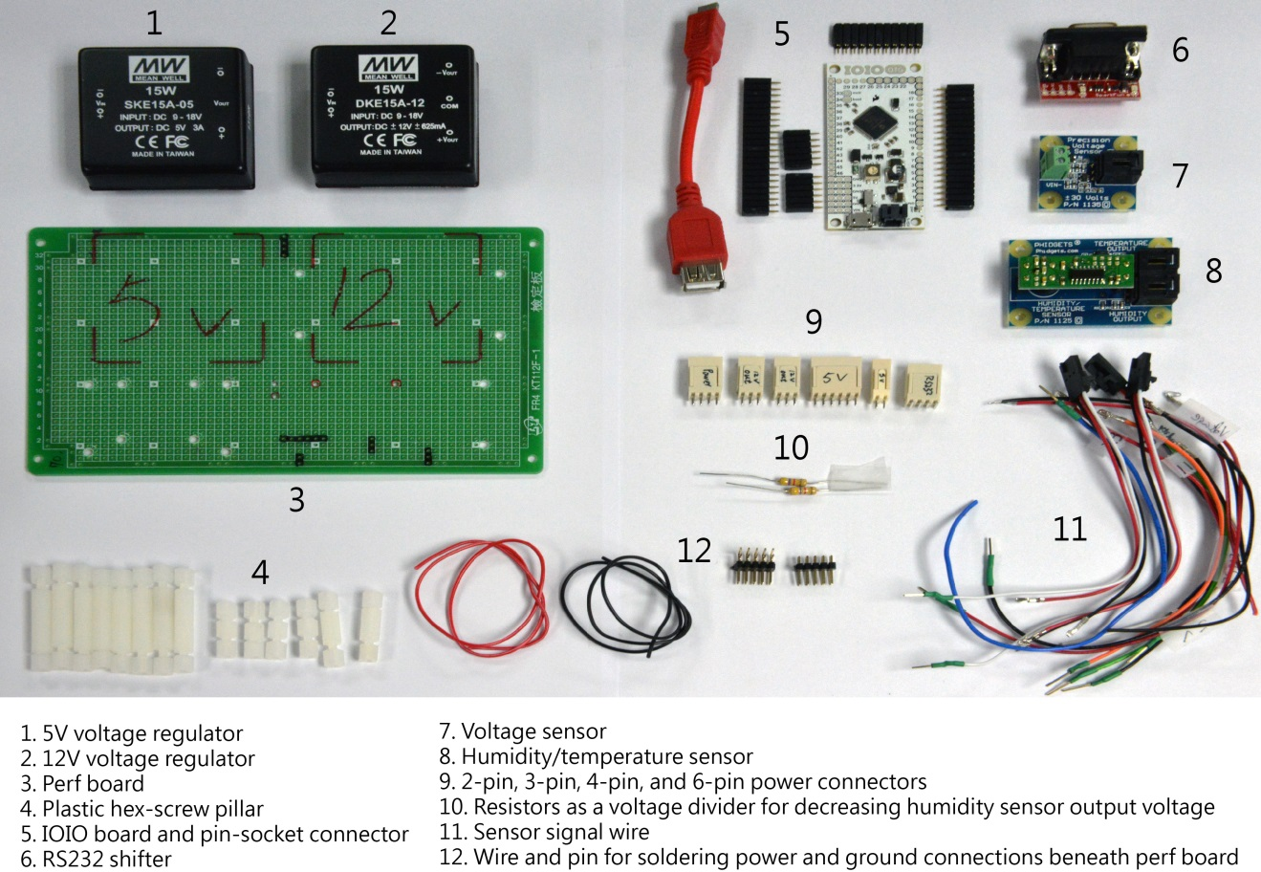
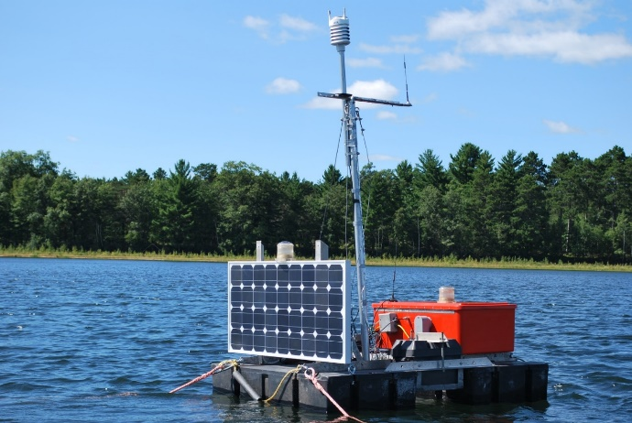
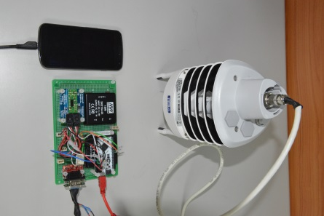
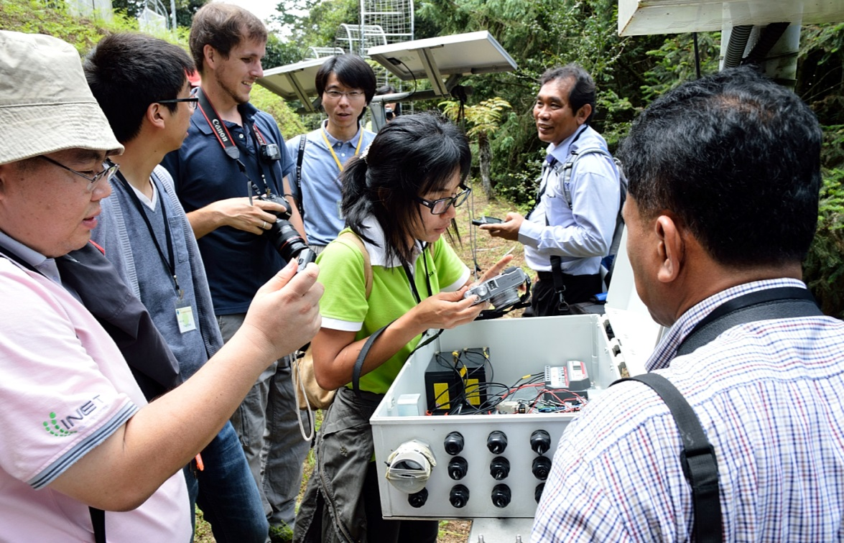
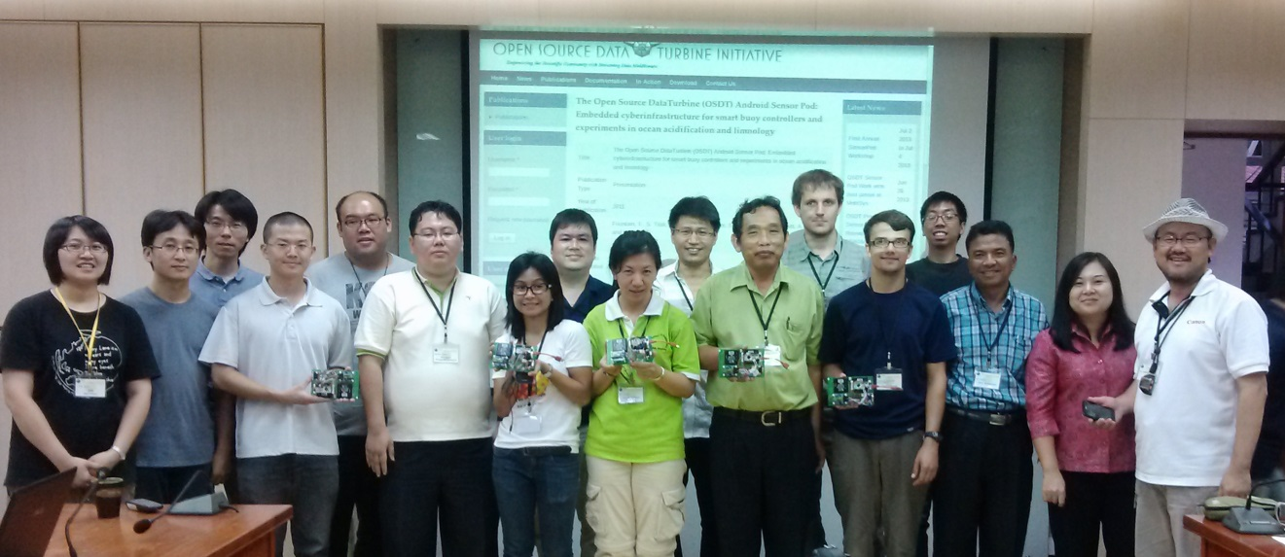
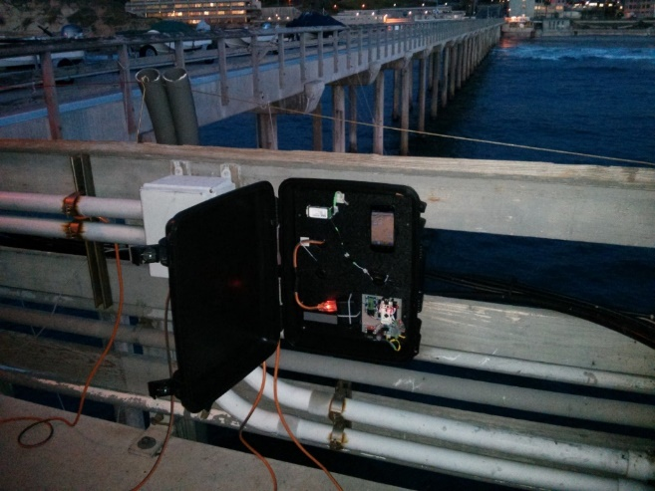
Mobile Technology and Clouds: Development, Deployment, Community Building
OSTD Android SensorPods: Rapid deployment of sensors, data stream to cloud (http://www.dataturbine.org/)
Prototypes of multiple pod management (Sensor Rocks) and monitoring (INCA – PRIME student)
Notes:
Application Pictures on Right
Lake in Northern Wisconsin – measuring temperature at various depths – part an experiment to reduce/eliminate an invasive species of smelt in the lake
Medical Plant Garden at Lienhuachih Research Station in Taiwan. Vaisala WXT 520 meteorological station with sensors for air pressure, humidity, temperature, rainfall, wind direction, and wind speed. Part of a larger effort to study biodiversity
3. SIO Peer – measuring temperature and ph, as a step towards a larger goal of observing , understanding ocean acidification
This OSDT Android SensorPod is mounted inside the open white box at the Medical Plant Garden at Lienhuachih Research Station in Taiwan. It is powered by solar panels and communicates via Wi-Fi to a DataTurbine server at the TFRI station.
An assembled OSDT Android SensorPod connected with a Vaisala WXT 520 weather station and Android smart phone.

Slide 18
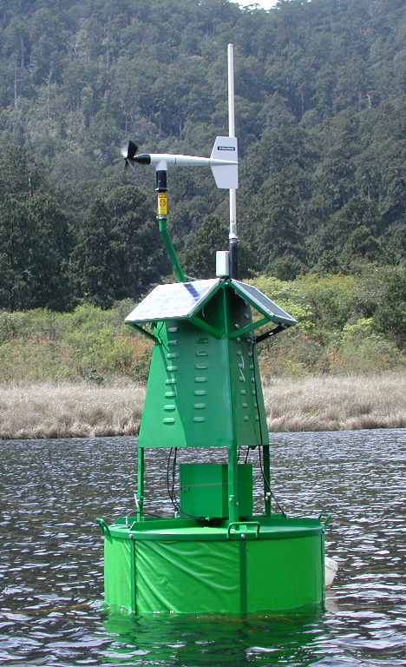
Scalable instrumentation and cyberfrastructure is critical
We can do this scale now
http://lakemetabolism.org
Source: T Kratz
Notes:
Series of three slides (circa 2007) that tried to spell out where we were in deploying sensors (in a lake setting).
We are getting to a place now – with integration of grid/cloud technologies (e.g. rocks cluster management system, INCA monitoring) with inexpensive SensorPods (custom-designed mobile computing platform for assembling wireless sensor networks for environmental monitoring applications) to scale up deployments and monitoring of many sensors.

Slide 19

Problematic, but possible with today’s cyberinfrastructure
Notes:
Source: T Kratz

Slide 20

Not currently possible
Scale needed to answer regional/continental questions
Notes:
Source T Kratz

Slide 21
Challenge
What is PRAGMA’s role in
cloud-mobile technology
development?
Notes:
As noted before: We are getting to a place now – with integration of grid/cloud technologies (e.g. rocks cluster management system, INCA monitoring) with inexpensive SensorPods (custom-designed mobile computing platform for assembling wireless sensor networks for environmental monitoring applications) to scale up deployments and monitoring of many sensors.
I would like us to think about this challenge – to see if it makes any sense.

Slide 22
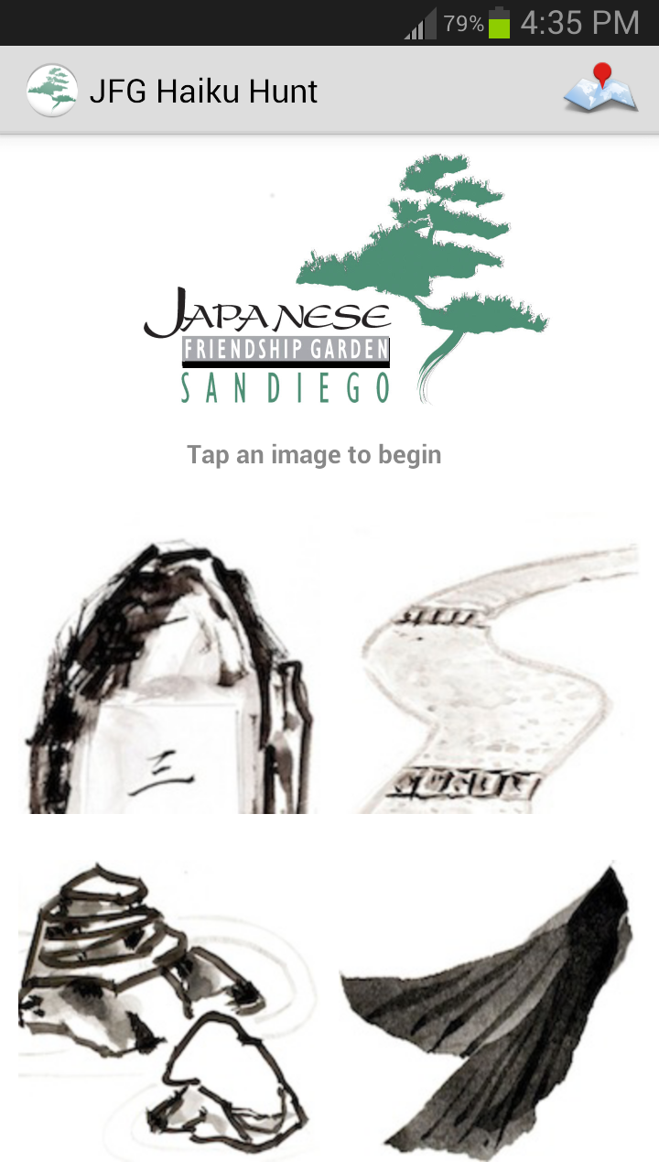
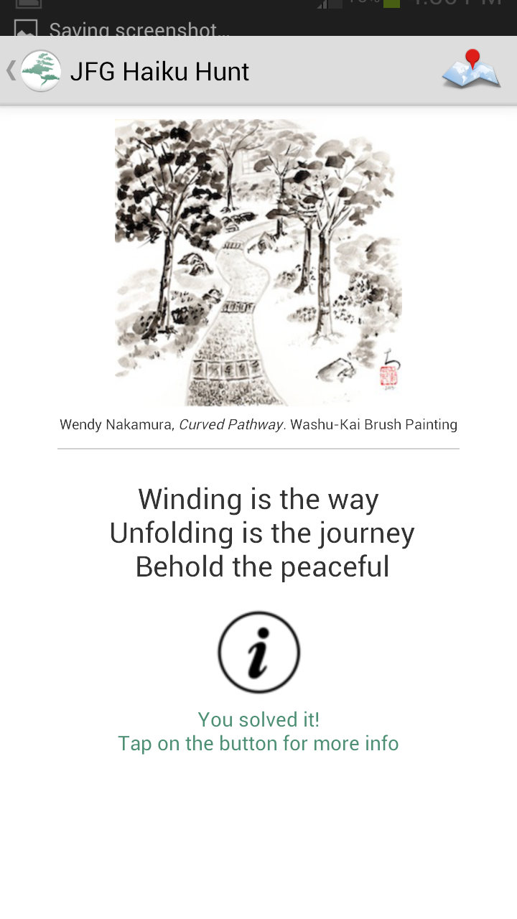
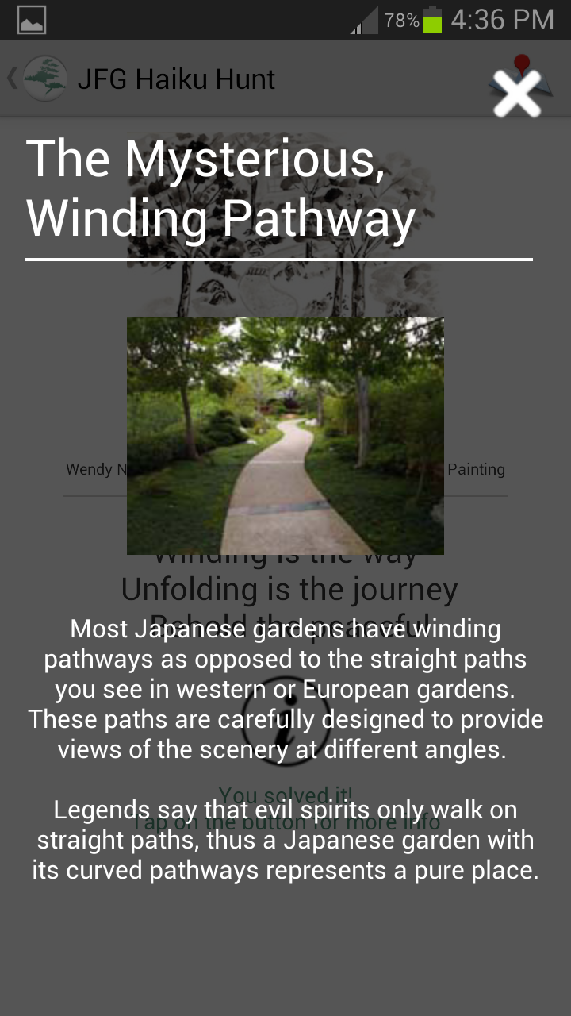
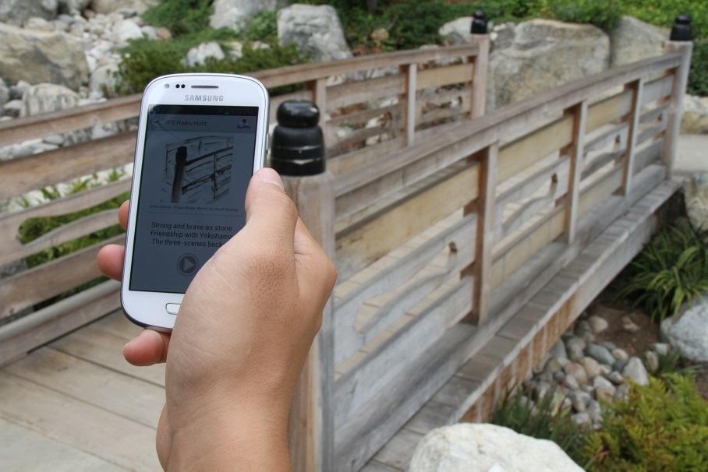
San Kei En Project (Japanese Friendship Garden Haiku Hunt)
Android-based, location-aware mobile application
First outside use of Place Sticker technology to preserve beauty, maintain connectivity
Fun! Haiku! Impact!
Demo: UCSD: Jason Haga, Jesus Rios (PRIME 2013); Osaka U: Shinji Shimojo;
BPOC: Vivian Haga, Wesley Hsu (PRIME 2011); ISID: Kazuhiro Toda;
Ritsumeikan U: Nobuhiko Nishio
Notes:
Top set of three images: screen shots from the application
Screenshots from JFG (Japanese Friendship Garden) android app: main page, solved winding pathway screen, and detailed information screen.
Lower image, at the Japanese Friendship Garden with image on phone of bridge – also in background
KEY POINTS:
- PRIME STUDENT
- Will go live later this month or early next month
- First outside application of technology

Slide 23
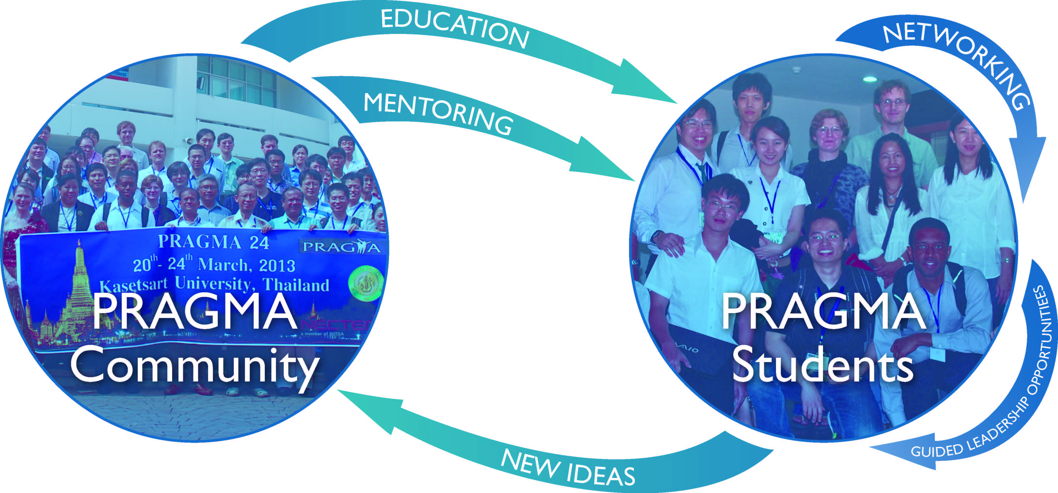
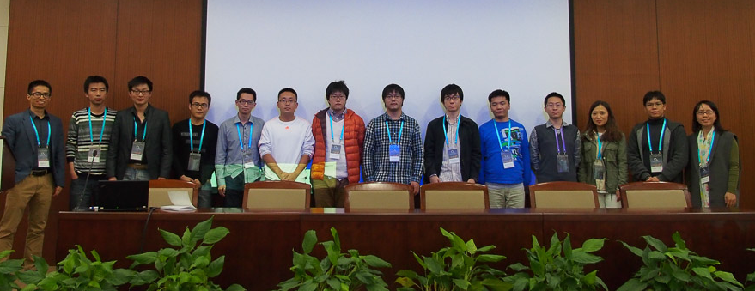
PRAGMA Students: Contributions
Workshop Shops for Students
Poster Sessions for PRAGMA
Distributed Seminar for PRAGMA
Involvement in Projects and Research
Notes:
PRAGMA Students was motivated by GLEON Student Association
PRAGMA made a strategic decision to engages students actively and intentionally in many PRAGMA activities – since it benefits PRAGMA and it benefits students.
Students already contribute to PRAGMA, Students also benefit from PRAGMA

Slide 24
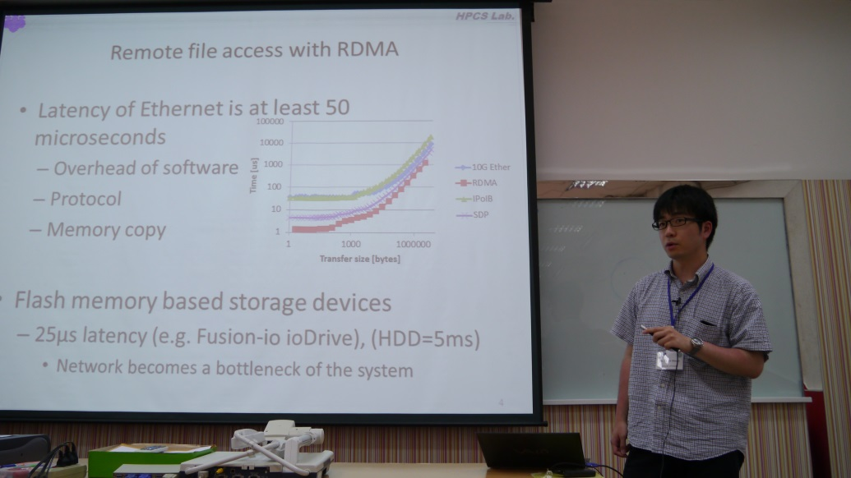

PRAGMA Students: Benefits
Gain professional experience interacting in an international setting
Create lasting network of international peers through working with peers on joint efforts
Strengthen research through engagement with mentors/advisors outside students’ home institution
Undertake opportunities for short-term visits by undergraduate / early PhD student
To succeed we need your enthusiastic support!
Notes:
Upper Right – PRAGMA 24 Workshop – Student workshop – presentation
Lower Right – PRAGMA 24 Workshop – Building a network
This is still work in progress – and we need to identify ways to integrate student research and PRAGMA projects

Slide 25
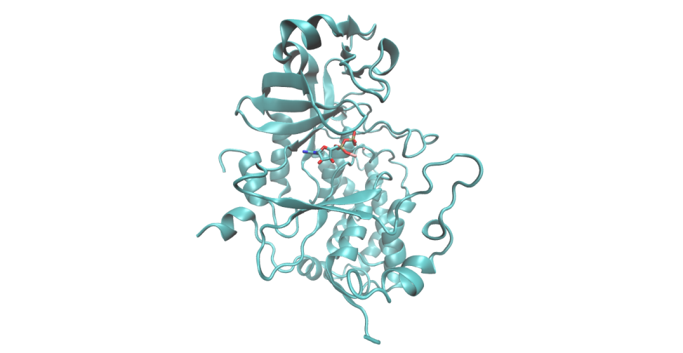
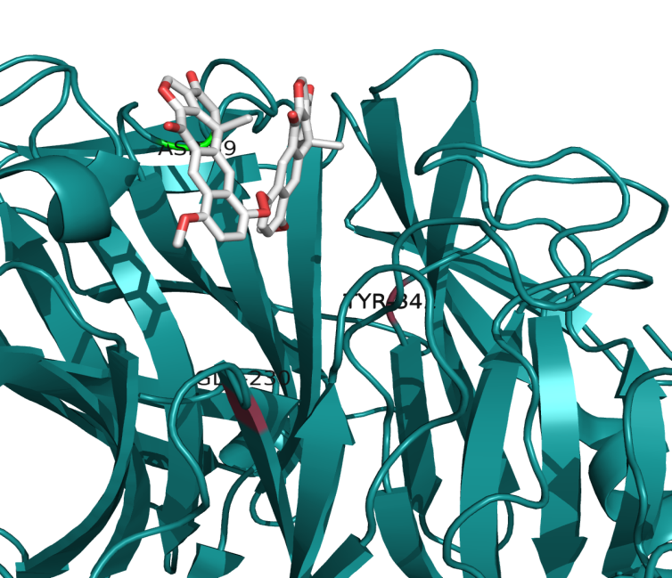
PRIME 2013: Advancing PRAGMA Activities
Projects
Institutions
Extend Android SensorPod to new application
Prototype INCA monitoring to mobile technology
Develop Haiku Hunt and deploy Place-Sticker technology to out doors
Implement images for virtual screening
Use computer technology for drug discovery in infectious and other diseases
Nara Institute of Science and Technology (NAIST)
National Institute for Information and Communication Technology (NICT)
National Taiwan University (NTU)
Osaka University
Taiwan Forest Research Institute (TFRI)
University of Auckland
University of Queensland
PRAGMA can support these opportunities for our students
Students build connections between PRAGMA members
Notes:
Part of a larger strategy for students is to build on activities like PRIME (Pacific Rim Experiences for students), Monash and Queensland University Research Program Abroad (MURPA, QURPA) – by exposing students to research in a different culture.
This is PRIME’s 10th year. We have supported more than 180 students to have this 3 quarter experience, which involves 9 weeks at a host lab.
As you can see, the institutions on the right are hosts to these undergraduate students from UCSD. Often, they have be able to support the students – for which we are very grateful.
Of the six projects listed, on the left hand side, the first three involved mobile computing.
The fourth one is trying to use virtualization to provide consistency of results independent of particular hardware, and to take steps to address a critical problem – that if virtual screening of possible drug compounds via docking.
The last two projects are about research on molecules or docking
- in one case (upper right) it is about a kinase (Fam20c), whose mutation is know to lead to osteoclerotic bone dysplasia in humans, also known as Raine syndrome. Raine syndrome is characterized by ectopic calcification which increases bone density and often causes death in neonatal stages.
In Short: the image is of Fam20C protein structure with ADP bound at its ATP binding pocket. (Sharon Grubner – working at National Taiwan University)
The image in the lower right is Dihalenaquinolide A docked to Trans-sialidase (Hanne Wolff – working at National Taiwan University)
Background: The focus is address Chagas disease – caused by a protozoa. Recently there is a focus on developing drugs that attach the protozoa. In particular we are looking at Trans-sialidase (TcTS), found on the membrane of the protozoan. The project looked at natural products in Taiwan to see which might bind and interrupt the protozoa (this is done in computer). One was Dihalenaquinolide A

Slide 26
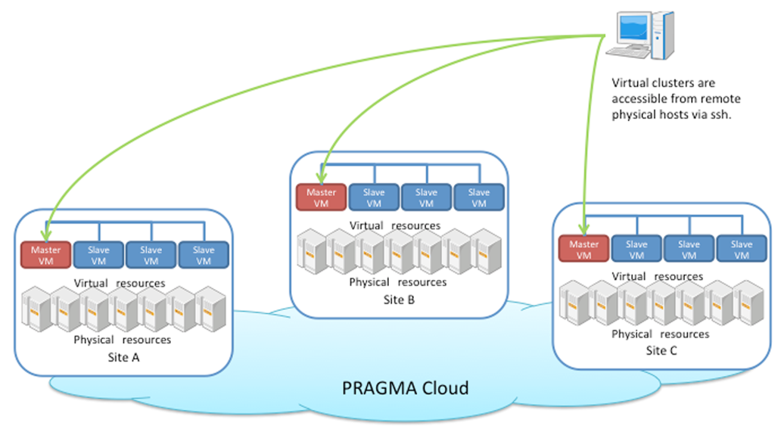
Deployment of Virtual Clusters for Molecular Docking Experiments on the PRAGMA Cloud
Docking experiments are key tool in silico drug discover
Physical grid computing can create inconsistent results - heterogeneity
Impacting results
Demonstrated by PRIME student (2009)
Used pragma_boot
Long-term goal: improve virtual dock
Demo: Kohei Ichikawa (NAIST),
Kevin Lam, Karen Rodriguez (PRIME 2013)
Wen-Wai Yim (PRIME 2009), Jason Haga UCSD
Notes:
This is a demo at the workshop, with work done by PRIME students with mentors at NAIST.

Slide 27
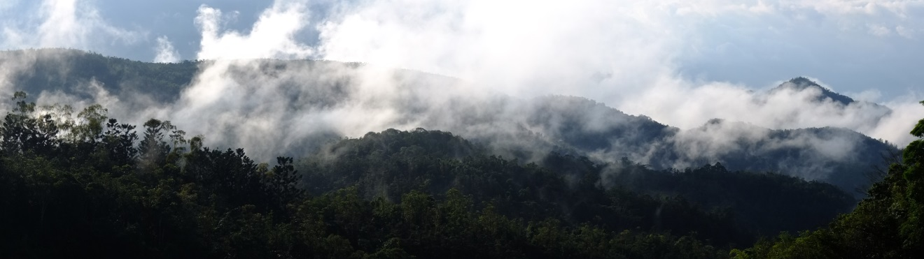
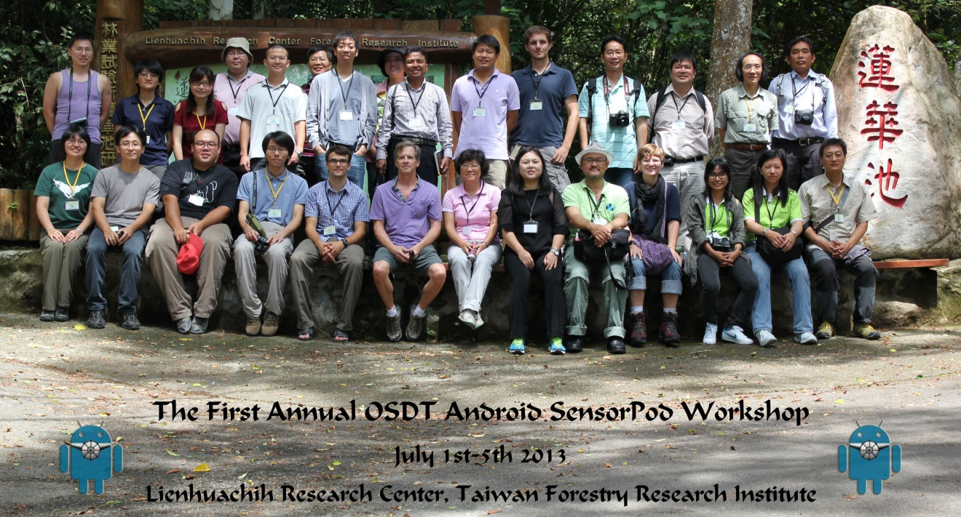
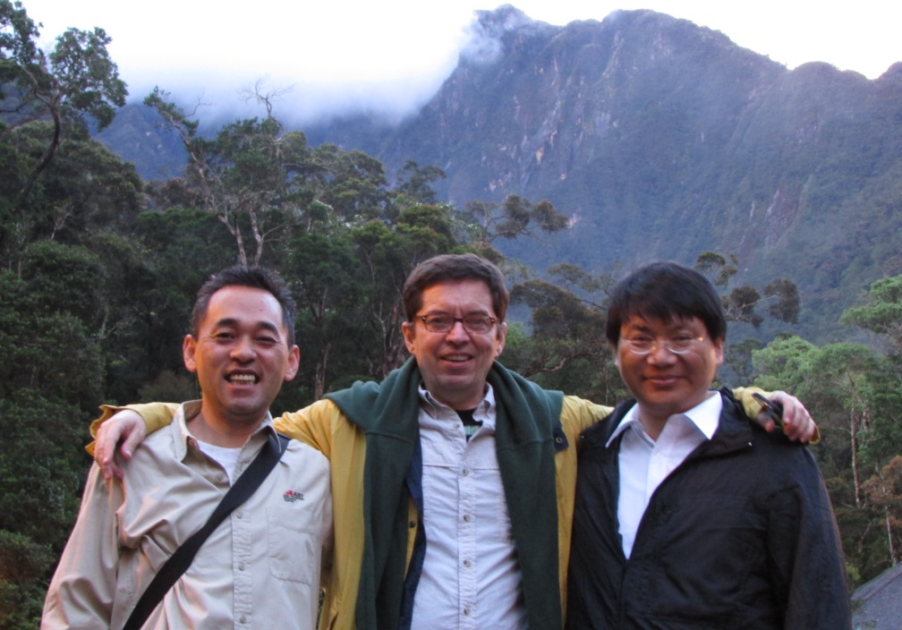
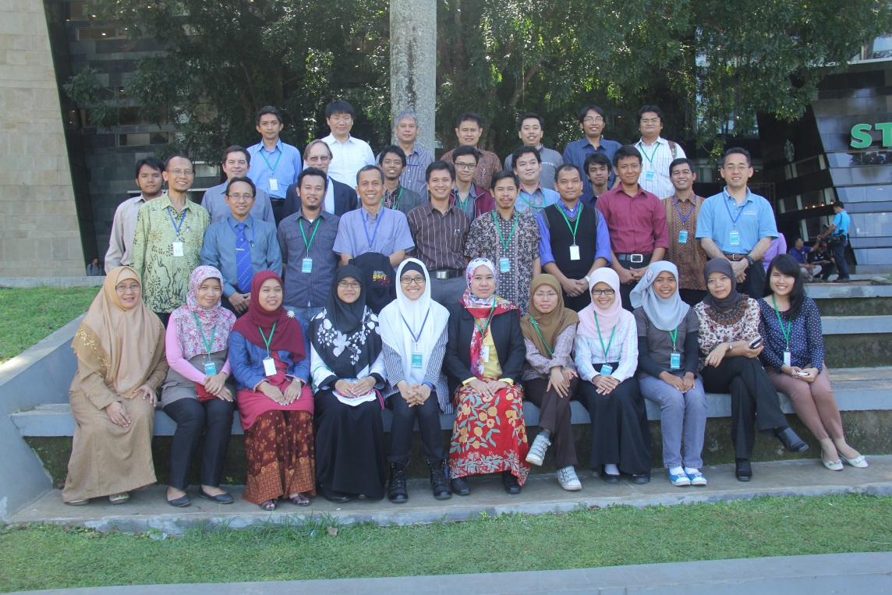
Building Communities
Biodiversity
New interactions
Environmental Observing Communities
Training & new deployments
Mini-PRAGMA Indonesia
New activities
New workshops!
Notes:
Images Upper Right
- Mountainous landscape of Lienhuachih Research Center
- 1st OSTD (Open Source Data Turbune) Android Sensor Workshop, July 2013 – Taiwan Forestry Research Institute (follow-up to PRAGMA 24 workshop on Biodiversity and Environmental Observing
Lower Left: Mini- PRAGMA in Indonesia (June 2013)
Lower Right: Advanced Team doing a REAL expedition of Mt Kinabalu – in preparation for future workshops and work there.
Key points: PRAGMA Intentionally engages new groups – to help keep our thinking fresh

Slide 28
Cyber Learning Working Group
Objectives
Providing cyber education & research environments in computational science
Utilizing Computing resources & services in PRAGMA community
Promoting developing & utilizing activities through global collaborations
G
O
A
L
Development of Education open platform and education/research S/W
Establishment of international research communities and connections to higher education
Construction of collaboration channels amongst PRAGMA WG
Collaborations
Other WGs
(Resource/Tele-Science
Bio/Geo)
PRAGMA Community
Activities
Cyber
Learning
WG
Education/Research,
S/W development
Web based Portal Service
Workshop/Seminar/Contest
Sharing Computing Resource
(middleware/SaaS/Cloud Computing)
Source: Kum Won Cho
Notes:
At PRAGMA 24 we had a preliminary meeting of a group on Cyber-Learning. This is motivated by KISTI’s work on Edison. At this workshop you will hear an update, and there will be an opportunity to help develop this activity into a working group.

Slide 29
Working Groups, Expeditions, Students
PRAGMA Cloud
VM/VC Experiments
Overlay Networks
Data Provenance
Scientific Understanding
Community Tools
Resources
Biodiversity Expedition
Data Discovery
Virtualization
Overlay Networks
Earth Observing &
Sensors
i
Interface to Integrate
Earth Observing
GEO
PRAGMA
Students
Sensor Networks
Remote Control
Network Applications
Telescience
Biosciences
Avian Flu Grid
Infectious Disease
Cyber-Learning
Notes:
Working Groups are incubators of projects and collaborations
Expeditions focus on science, but interface / engage working groups
(My hope) Students will find an exciting set of research projects in this interface of expeditions and working groups.

Slide 30
Sustainability of PRAGMA
Growing Future Leaders
Succession planning
Products
What is it we do? Students, Software, People network (access)
Future Funding Model
Provide stability for coordination
What is PRAGMA – or how to articulate it
Global Organization
Cradle of international idea – bring an idea and grow it
Fluid network of trust
From PRAGMA 24
22 March 2013
Notes:
NOT FOR IEEE

Slide 31
Subcommittees of Steering Committee
Sustainability of PRAGMA
Chair: Jim Williams
PRAGMA Students
Co-Chairs: Beth Plale, Karpjoo Jeong
Review the issue of sustainability
Review/revise components on
Grow Leaders
Create funding models
Develop clearly defined products
Discuss and recommend strategies and implementable approaches that would help PRAGMA continue to be successful
Develop strategies and implementable approaches to
Align long-term nature of grad student research with short-term PRAGMA projects
Support (financially) graduate student participation on PRAGMA
Provide the networking, leadership, and research opportunities for students in PRAGMA
Notes:
NOT FOR IEEE

Slide 32
Steering Committee Topics
SC Members Present
Topics
Wing Keung Kwan (HKU)
Fang-Pang Lin (NCHC)
Kai Nan (CNIC)
Phil Papadopoulos (UCSD)
Shinji Shimojo (Osaka U)
Yoshio Tanaka (AIST)
Whey-Fone Tsai (NCHC)
Putchong Uthayopas (KU)
Xiaohui Wei (JLU)
Jim Williams (ex officio)
Baoping Yan (CNIC)
Sustainability of PRAGMA
Jim Williams Chair , Shinji Shimojo, Osaka U; Jose Fortes, U Florida; Philip Papadopoulos, UCSD; Yoshio Tanaka, AIST; Whey-Fone Tsai, NCHC
PRAGMA Students
Beth Plale, Indiana U, co-chair; Karpjoo Jeong, Konkuk U, co-chair; Putchong Uthayopas, Kasetsart U; Susumu Date, Osaka U; Paul Hanson, U Wisconsin; Meilan Jiang, Konkuk U; Gabriele Zhou, Indiana U; Yuan Luo, Indiana U
Notes:
NOT FOR IEEE
Satoshi Sekiguchi - National Institute of Advanced Industrial Science and Technology (AIST) • Yoshio Tanaka - National Institute of Advanced Industrial Science and Technology (AIST) • Whey-Fon Tsai - National Center for High-performance Computing (NCHC) • Fang-Pang Lin - National Center for High-performance Computing (NCHC) • Shinji Shimojo - Osaka University • Susumu Date - Osaka University • David Abramson - University of Queensland • Habibah Wahab - Universiti Sains Malaysia (USM) • Putchong Uthayopas - Kasetsart University • Karpjoo Jeong - Konkuk University • Kum Won Cho National Institute of Supercomputing and Networking (NISN), Korea - Institute for Science and Technology Information (KISTI) • Kan Nan - Computer Network Information Center (CNIC), Chinese Academy of Sciences • Xiaohui Wei - Jilin University • Vinh Quang Thai - Institute of Information Technology (IOIT), Vietnamese Academy of Science and Technology • Philip Papadopulos - University of California San Diego (UCSD) • Peter Arzberger - University of California San Diego (UCSD) • James Williams - TransPAC3

Slide 33
This is Your Workshop
Working Groups: 4 (~4.5 hours)
Demos: 6 (2 hours) – from working groups
Posters: 23 (1.25 hours)
Opportunities to start collaborations / use the collective resources
Engage!
Notes:
NOT FOR IEEE

Slide 34
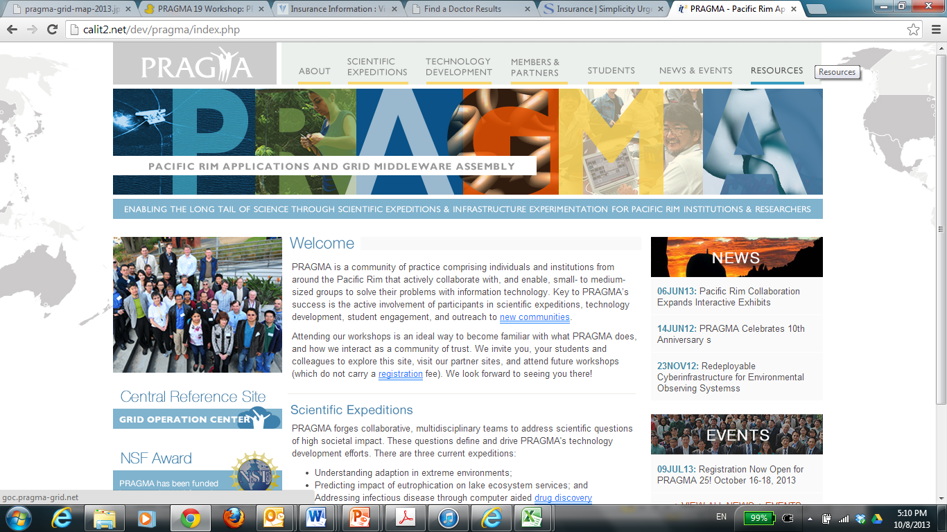
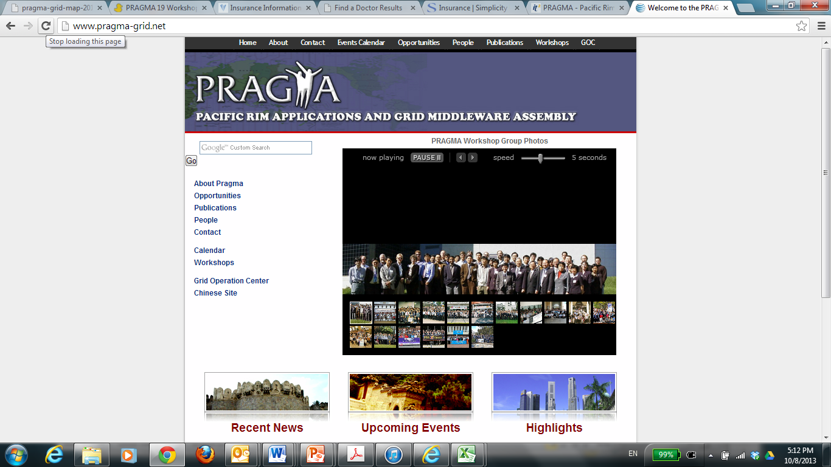
Our NEW PRAGMA Website
Notes:
It is time for a face lift – we are working on one now – that will reflect our PRAGMA Collaborative Overview
But this is your website – we welcome ideas for content

Slide 35
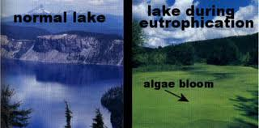



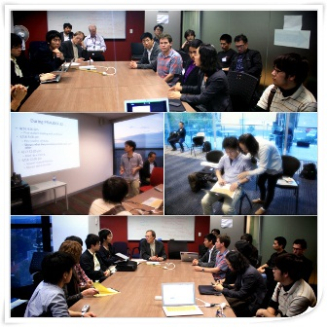
Enabling the Long Tail of Team Science
Virtual Scientific Expeditions
Trust Envelop
PRAGMA Students
PRAGMA Member Sites
PRAGMA Community
Notes:
If I had one slide to sum up PRAGMA’s activity – this might be it
- Driven by applications (upper left)
- Driving toward a Trust envelop by application needs
- Engaging students (lower right)
- community based (lower right)
- this is who we are – enabling the long tail of (team) science
Mini-PRAGMA in Indonesia
http://minipragma.cs.ui.ac.id/

Slide 37
Leverage with other projects
GEO Grid
iDigBio
DataONE
AP BON
Other project Ito

